Slide 1







Connecting regional employers, job seekers, community colleges and government agencies

Slide 2


Employer
College
Weak Signal
Open
Jobs
Available
Training
Current State:
Disconnect among stakeholders in the training-job cycle.
?
The problem:
No systematic connection between the stakeholders.
The result:
No way to systematically speed up filling open jobs with appropriately trained jobseekers.

Slide 3

Employer
College
Weak Signal
Open
Jobs
Available
Training
Current State:
Disconnect among stakeholders in the training-job cycle.
?
The problem:
No systematic connection between the stakeholders.
The result:
No way to systematically speed up filling open jobs with appropriately trained jobseekers.
Job
Seeker
Individual

Slide 4
Employer
College
Strong Signal
Stakeholder Data Exchange
Talent Supply Chain
College to employer supply chain based on predictive analytics.
Next Step:
Software platform that proactively connects stakeholders.
Skills-Based Training
Models competencies as a currency. Analyzes jobs based on competencies.
Stakeholder Apps
Individual

Slide 5














Tucson Companies and Organizations
COMPANIES
ORGANIZATIONS

Slide 6








Competitive Landscape
Predictive
LMI
No Institutional
Signaling
Strong Institutional
Signaling
No Labor Market
Information (LMI)

Slide 7

Innovations and Differentiators
Predictive Analytics
Competency as Currency
Real-time Signaling
Social Channel
Local Focus

Slide 8
Where we are now
Full Solution
Limited App
Data-Driven/ Cloud Service
Staged Pilot
Specification
Engage with Stakeholders
Employer Interviews
Organization Interviews
Identify Use Cases
Conceptualize Software
Vet with stakeholders
Develop JobSignals software
Deploy limited functionality platform
Iteratively integrate and test
Refine based on pilot
Expand stakeholders to include agencies
Add more employers
and schools
Evolve to a
national model
Pima
National

Slide 9
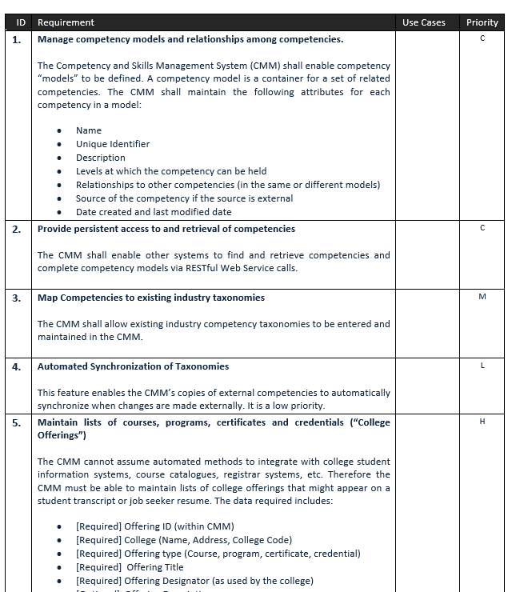
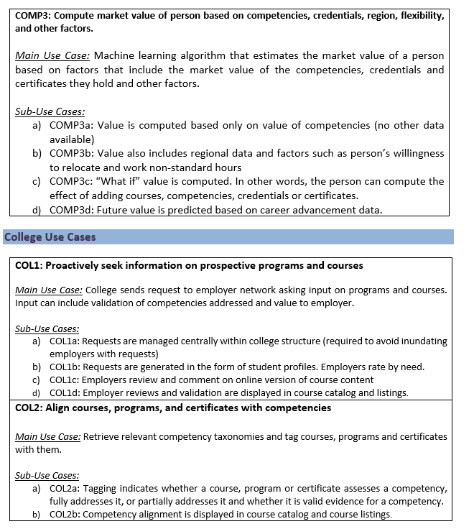
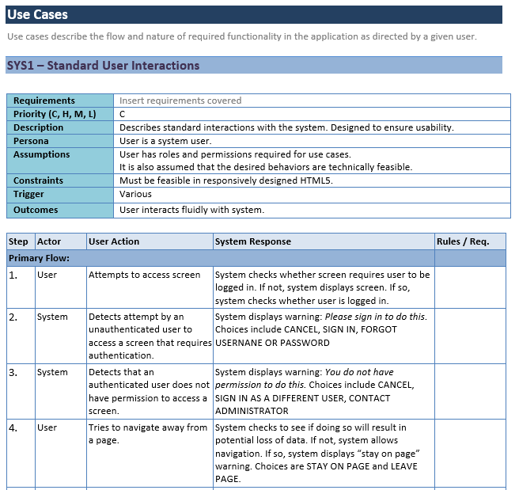
What does a “specification” look like?

Slide 10
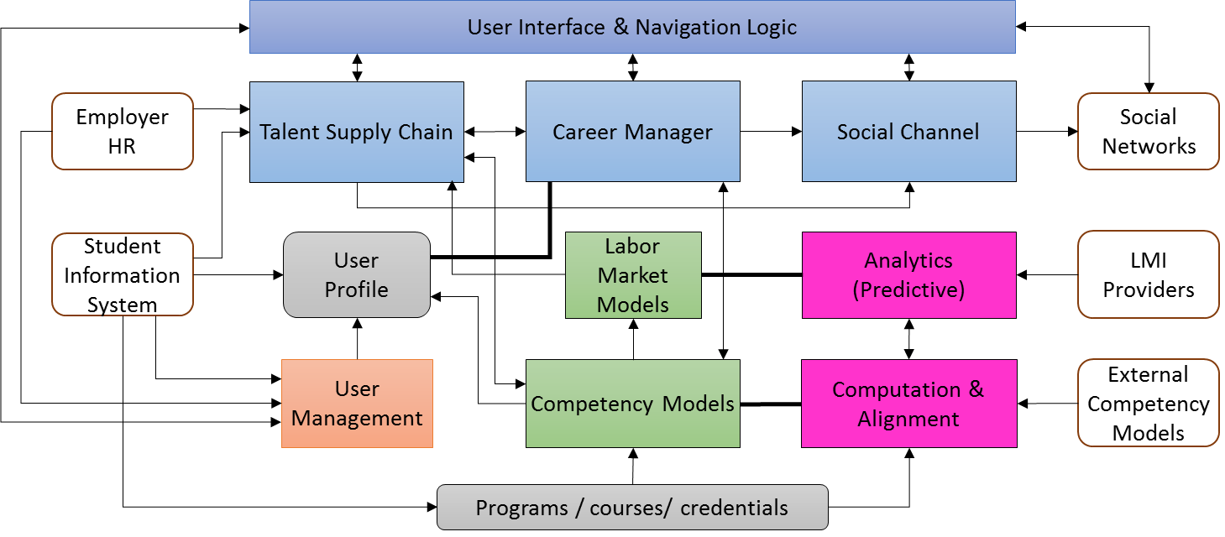
System Architecture
Multiple role options for each type of user – simplifies navigation (users only see the screens and functions they need) and supports data security
Modular design supports scalability and maintainability; facilitates addition of future functionality and data sources
System architecture and technical design follows best practices for system security, including appropriate user authentication, encryption, and coding practices to prevent unauthorized external access; system will be secured for cloud-based deployment
System is designed for ease of integration using standards-based APIs and RESTful JSON web-services

Slide 11
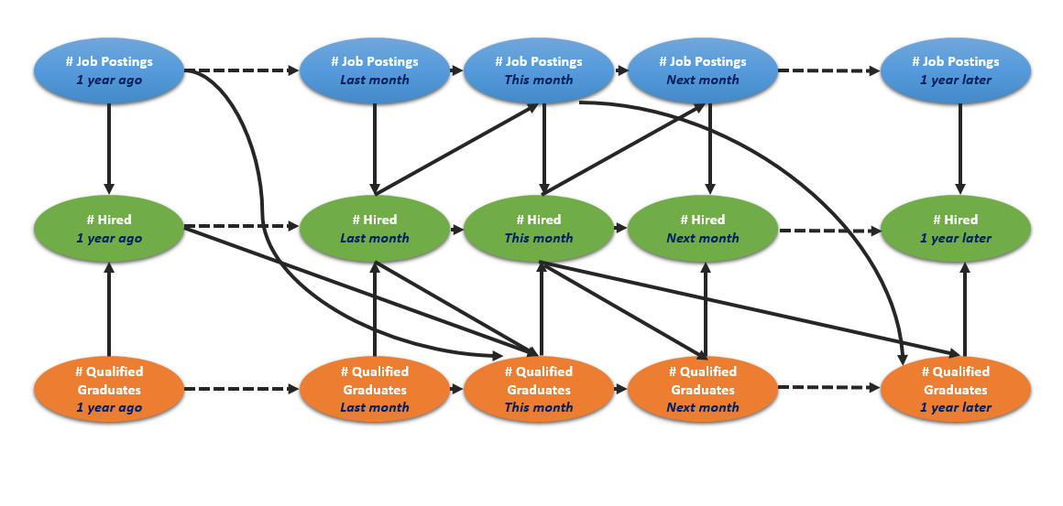
Predictive Analytics
Labor Market Supply & Demand Modeling
Uses local and regional LMI combined with pipeline data from colleges to predict future supply and demand for jobs and skills
Predicts median and entry-level salary based on labor market forecasts and regional supply and demand.
Competency as Currency
Maps competencies to courses and jobs
Computes expected salaries of a given combination of competencies based on labor market models
Derives the marginal value of adding any given additional competency to a user’s current profile
Algorithm Design
LMI and pipeline predictions influence future values
Modeled as a Markov network that can handle missing data
Model includes data on adjacent job titles and college credentials
Includes configuration management of job titles and skills taxonomies
Second overlay model used to compute value of sets of competencies

Slide 12















Employer
College
Job Seeker
Message From PCC
A PCC instructor wants to contact you regarding Additive Manufacturing training.
New Talent Request
Employers have signaled a future need for Additive Manufacturing. Tap here for details.
New Career Path
Have you considered Additive Manufacturing? You already have 60% of the needed skills.
Find Talent
Connect with training providers
Recruit Students
Reach out to enrolled students
Explore Job Market
Manage my career
Find Training
Upgrade your competencies
Advise Students
Help students with career paths
Get Training
Find programs and support
Analyze Labor Market
See supply and demand
Analyze Labor Market
Analyze and predict job openings
Evaluate My Skills
Estimate your job market value
Send Job Signal
Broadcast future needs
Analyze Institution
Compare programs to needs
Get Advice
Career services and networks
Additional Options...
Additional Options...
Additional Options...

Slide 13
Employer
College
Job Seeker
Message From PCC
A PCC instructor wants to contact you regarding Additive Manufacturing training.
New Talent Request
Employers have signaled a future need for Additive Manufacturing. Tap here for details.
New Career Path
Have you considered Additive Manufacturing? You already have 60% of the needed skills.
Find Talent
Connect with training providers
Recruit Students
Reach out to enrolled students
Explore Job Market
Manage my career
Find Training
Upgrade your competencies
Advise Students
Help students with career paths
Get Training
Find programs and support
Analyze Labor Market
See supply and demand
Analyze Labor Market
Analyze and predict job openings
Evaluate My Skills
Estimate your job market value
Send Job Signal
Broadcast future needs
Analyze Institution
Compare programs to needs
Get Advice
Career services and networks
Additional Options...
Additional Options...
Additional Options...

Slide 14
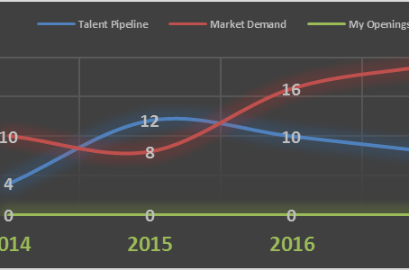
Analyze Labor Market
College
Job Seeker
Talent Pipeline for Additive Manufacturing Tech near Tucson, AZ
New Talent Request
Employers have signaled a future need for Additive Manufacturing. Tap here for details.
New Career Path
Have you considered Additive Manufacturing? You already have 60% of the needed skills.
2014 - 2017
By Year
By Quarter
Recruit Students
Reach out to enrolled students
Explore Job Market
Manage my career
Advise Students
Help students with career paths
Get Training
Find programs and support
Analyze Labor Market
Analyze and predict job openings
Evaluate My Skills
Estimate your job market value
Tap a year to see more detail.
Analyze Institution
Compare programs to needs
Get Advice
Career services and networks
Share Data
Signal Openings
Additional Options...
Additional Options...

Slide 15

| Analyze Labor Market
Employer|
Sign Out
Talent Pipeline for Additive Manufacturing Tech near Tucson, AZ
⬇ Download Data
2014-2017
Show by Year
Show by Quarter
Signal Opening
Tip: Select a year to see more details.
Copyright • Terms of Use • Contact Us
Notes:
The demand picture shows how many openings there will be each quarter and
how many people will be available to fill each opening (coming from colleges).
Salaries ranges quartiles will also be available for view.

Slide 16
| Analyze Labor Market
Employer|
Sign Out
Talent Pipeline for Additive Manufacturing Tech near Tucson, AZ
⬇ Download Data
2016
Signal Opening
Qualified: 98
Almost Qualified: 14
Most Common Skill Gaps
Additive manufacturing economics
Design strategies for AM
Selecting AM materials and processes
Good
Talent Supply
Market Salary
$61,000
Copyright • Terms of Use • Contact Us
Notes:
The demand picture shows how many openings there will be each quarter and
how many people will be available to fill each opening (coming from colleges).
Salaries ranges quartiles will also be available for view.

Slide 17
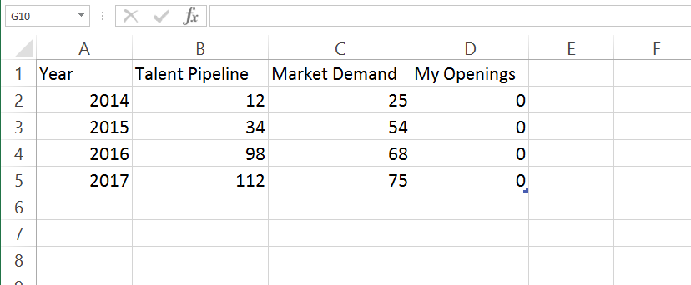
| Analyze Labor Market
Employer|
Sign Out
Talent Pipeline for Additive Manufacturing Tech near Tucson, AZ
⬇ Download Data
2016
Signal Opening
Qualified: 98
Almost Qualified: 14
Most Common Skill Gaps
Additive manufacturing economics
Design strategies for AM
Selecting AM materials and processes
Good
Talent Supply
Market Salary
$63,000
Copyright • Terms of Use • Contact Us
Notes:
The demand picture shows how many openings there will be each quarter and
how many people will be available to fill each opening (coming from colleges).
Salaries ranges quartiles will also be available for view.

Slide 18

| Analyze Labor Market
Employer|
Sign Out
Talent Pipeline for Additive Manufacturing Tech near Tucson, AZ
⬇ Download Data
5
2016
Signal Opening
Qualified: 98
Almost Qualified: 14
Most Common Skill Gaps
Additive manufacturing economics
Design strategies for AM
Selecting AM materials and processes
Good
Talent Supply
Market Salary
$63,000
Copyright • Terms of Use • Contact Us
Notes:
The demand picture shows how many openings there will be each quarter and
how many people will be available to fill each opening (coming from colleges).
Salaries ranges quartiles will also be available for view.

Slide 19
Employer
College
Job Seeker
Message From PCC
A PCC instructor wants to contact you regarding Additive Manufacturing training.
New Talent Request
Employers have signaled a future need for Additive Manufacturing. Tap here for details.
New Career Path
Have you considered Additive Manufacturing? You already have 60% of the needed skills.
Find Talent
Connect with training providers
Recruit Students
Reach out to enrolled students
Explore Job Market
Manage my career
Find Training
Upgrade your competencies
Advise Students
Help students with career paths
Get Training
Find programs and support
Analyze Labor Market
See supply and demand
Analyze Labor Market
Analyze and predict job openings
Evaluate My Skills
Estimate your job market value
Send Job Signal
Broadcast future needs
Analyze Institution
Compare programs to needs
Get Advice
Career services and networks
Additional Options...
Additional Options...
Additional Options...

Slide 20
| Analyze Institution
College|
Sign Out
Analysis of all Industrial Technology Programs near Tucson, AZ
⬇ Download Data
2014-2017
Show by Year
Show by Quarter
Explore Talent Supply chain. View by job title or skill
Find gap between demand and supply at your college and in region.
Suggest a Program
Copyright • Terms of Use • Contact Us
Notes:
The demand picture shows how many openings there will be each quarter and
how many people will be available to fill each opening (coming from colleges).
Salaries ranges quartiles will also be available for view.

Slide 21
| Analyze Institution
College|
Sign Out
Analysis of Trade Profession Programs at PCC
⬇ Download Data
2014-2017
Show by Year
Show by Quarter
Explore Talent Supply chain. View by job title or skill
Find gap between demand and supply at your college and in region.
Suggest a Program
Recruit Students
Copyright • Terms of Use • Contact Us
Notes:
The demand picture shows how many openings there will be each quarter and
how many people will be available to fill each opening (coming from colleges).
Salaries ranges quartiles will also be available for view.

Slide 22





| Social Channel
College|
Sign Out
Students on a path to Machine Tool Tech at PCC
#ABCDEFGHIJKLMNOPQ
Bob Smith
Student
Pima Community College
bob.smith@pima.edu ✓
bbsmith@yahoo.com
123-456-7890
345-678-9012
JS Message ✓
Google+
Skype
Joe Tanner
Suggested Contacts
Jane Dodge
Student, Pima Community College
Work
Personal
Work
Mobile
Social
Also contact
Bob Smith
Student, Pima Community College
Joe Tanner
Student, Pima Community College
Mateo Garcia
Student, Welding Program - PCC
+ Add
Copyright • Terms of Use • Contact Us

Slide 23
Employer
College
Job Seeker
Message From PCC
A PCC instructor wants to contact you regarding Additive Manufacturing training.
New Talent Request
Employers have signaled a future need for Additive Manufacturing. Tap here for details.
New Career Path
Have you considered Additive Manufacturing? You already have 60% of the needed skills.
Find Talent
Connect with training providers
Recruit Students
Reach out to enrolled students
Explore Job Market
Manage my career
Find Training
Upgrade your competencies
Advise Students
Help students with career paths
Get Training
Find programs and support
Analyze Labor Market
See supply and demand
Analyze Labor Market
Analyze and predict job openings
Evaluate my Skills
Estimate your job market value
Send Job Signal
Broadcast future needs
Analyze Institution
Compare programs to needs
Get Advice
Career services and networks
Additional Options...
Additional Options...
Additional Options...

Slide 24


| My Profile
Job Seeker
Sign Out
Contact Info
Experience & Skills
Career Goals
------------------------
View Profile
------------------------
Preferences
Job seekers enter their skills, certificates and work experience into their profile.
My Profile
Click on text to make edits
Contact
Skills
Goals
Preferences
Add skills →
Enter a skill, degree or job title
Search
My Skills
Blueprint reading
Cast iron repair
Joint weld
Oxyacetylene welding
Basic cutting skills
Reliability
Welding Safety
Brazing and soldering
Show all
Evaluate My Skills
Get Training
Notes:
The demand picture shows how many openings there will be each quarter and
how many people will be available to fill each opening (coming from colleges).
Salaries ranges quartiles will also be available for view.

Slide 25

| Measure My Skills
Student|
Sign Out
Salaries Near Tucson
Based on my current skills: $45,156
Edit My Skills
Entry Level Salary
Additive Manufacturing Technician - $61,000
Welder and Brazer
$39,640
Median Household Income ($44,600)
Size of Circles = Number of Jobs Available
Copyright • Terms of Use • Contact Us
Notes:
The demand picture shows how many openings there will be each quarter and
how many people will be available to fill each opening (coming from colleges).
Salaries ranges quartiles will also be available for view.

Slide 26

| Get Training
Student|
Sign Out
Get Training for Additive Manufacturing Technician near Tucson, AZ
+ Certificate
+ Associate Degree
My Relevant Skills
Machine Tool Tech
Mechatronics
Select a job
Blueprint reading
Joint weld
Oxyacetylene welding
Basic cutting skills
Brazing and soldering
Lathe Safety
Electrical Discharge
Machine Tool Programming
Metrology / Quality Control
Basic Algebra and Trig
Control Systems Design
Written Communication
CAD/CAM
Additive Manufacturing Tech
Build up components from 3D digital models by depositing material in layers.
You are 30% of the way here.
It will take about 40 credit hours to become fully qualified.
Current Value: $45,156
New Value: $53,238
New Value: $65,897
Market Salary $61,000
Evaluate My Skills
Find Training
Find Training
Connect with employees
Copyright • Terms of Use • Contact Us
Notes:
The demand picture shows how many openings there will be each quarter and
how many people will be available to fill each opening (coming from colleges).
Salaries ranges quartiles will also be available for view.

Slide 27
Result: Effective Signaling
Employer
College
Open
Jobs
Available
Training
Strong Signal
Stakeholders in the training-job cycle are connected and communicating
Stakeholders in the training-job cycle are meeting future rather than past needs
Job
Seeker
Individual

Slide 28
Drivers of Market Adoption
Employers:
Large businesses: Mission-critical impact on local talent supply
Small businesses: Previously unavailable connection with talent pipeline
Colleges:
Higher rate of return for dollars invested in programs
Better recruitment and career services tools
Job Seekers:
Shortest path between training and desired employment
Personal connection with employer mentors and career advisors

Slide 29
Pilot Proposal: Approximately 9 Months
Pilot Initiation ($50,000)
  Participant recruitment
  Pima preparation
Pilot Development ($350,000)
Pilot Execution ($250,000)
  Pima integration
  Employer integration
  Testing and evaluation
Next Steps
  Tucson launch
  Fundraising for national launch
Pima return on license
  10% of first $1.5M
  7% of net sales
Product
Pilot
Spec

